Slide 1
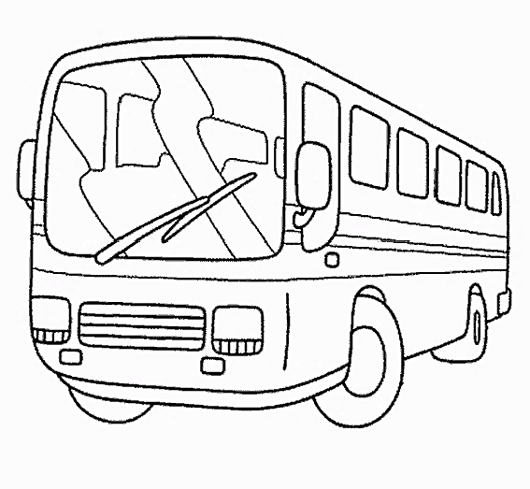
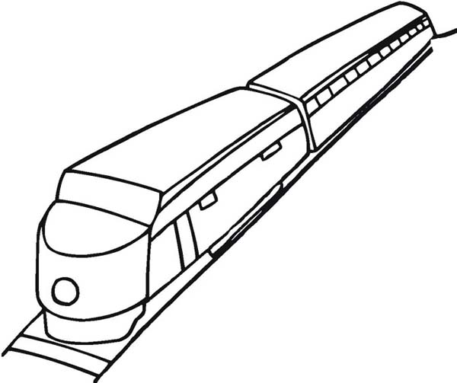
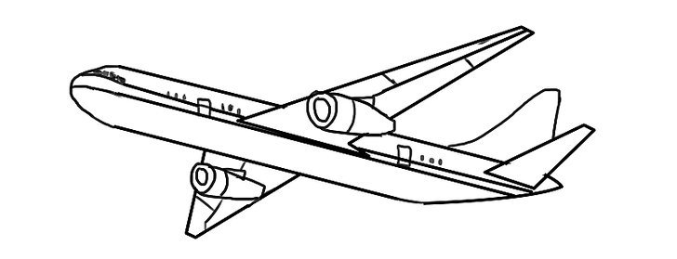
Asking the Way

Slide 2
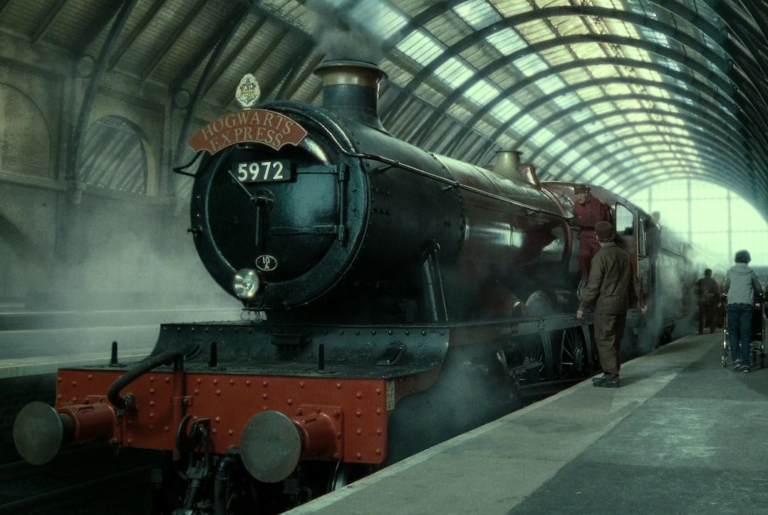
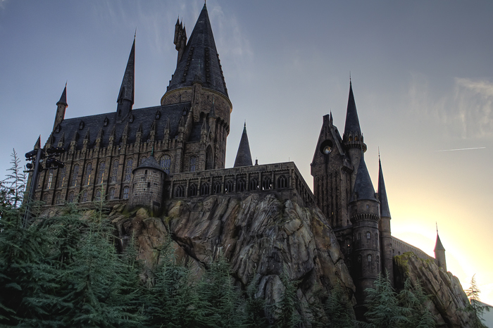



Asking the Way
in
Notes:
What is this place called? Wait for students to respond before telling them its Hogwarts! And today we will be taking the Hogwarts express.

Slide 3
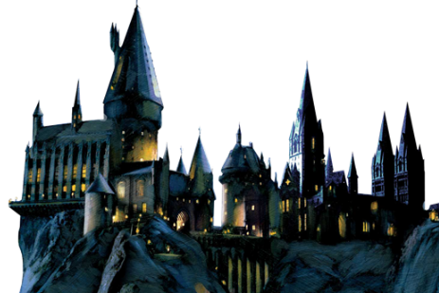


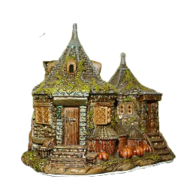

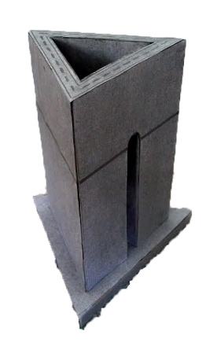
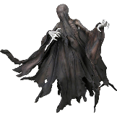





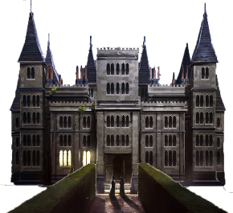




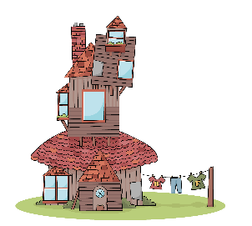
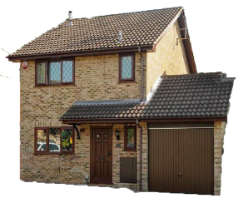
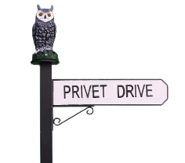
Forbidden forest
Dragon’s Den
North Sea
Hogwarts Station
Hogsmeade
Dark Pine
Honeydukes candy shop
Hagrid’s House
Hogwarts School
Three Broomsticks restaurant
Whitehall
Azkaban Prison
Ministry of Magic
West Lake
Godric’s Hollow
The Black Lake
East Lake Station
Malfoy’s House
The Leaky Cauldron
Diagon Alley
Wiltshire
Knockturn Alley
Charing Cross
Kings Cross
Gringotts Bank
Gold Goblin
The Burrow
Quidditch Stadium
Privet Drive
Dartmoor
Ron’s House
Harry’s House
Notes:
Explain that this is a map of the world of Harry Potter. Explain the difference between station names and place names.

Slide 4
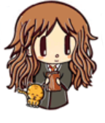
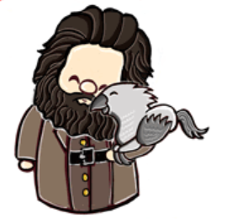
Excuse me.
Could you tell me how to get to The Forbidden Forest from Kings Cross?
Sure. Take the Black Line from platform 9 and three quarters (9¾). Then, change to the Blue line at West Lake.
Where do I get off?
At Dark Pine. The Forbidden Forest is near the station.
Thank you.
You’re welcome!

Slide 5
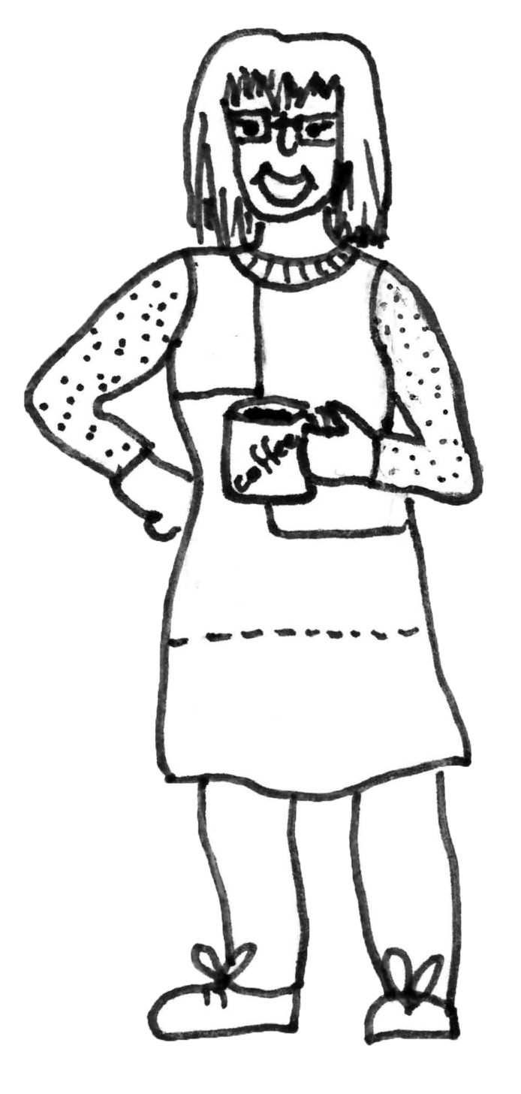
Excuse me.
How can I get to Petone station?
Excuse me.
I’m looking for The Dowse Art Museum.
Excuse me.
Is Hutt Valley High School near here?
Notes:
Explain some other ways of asking how to get somewhere.

Slide 6
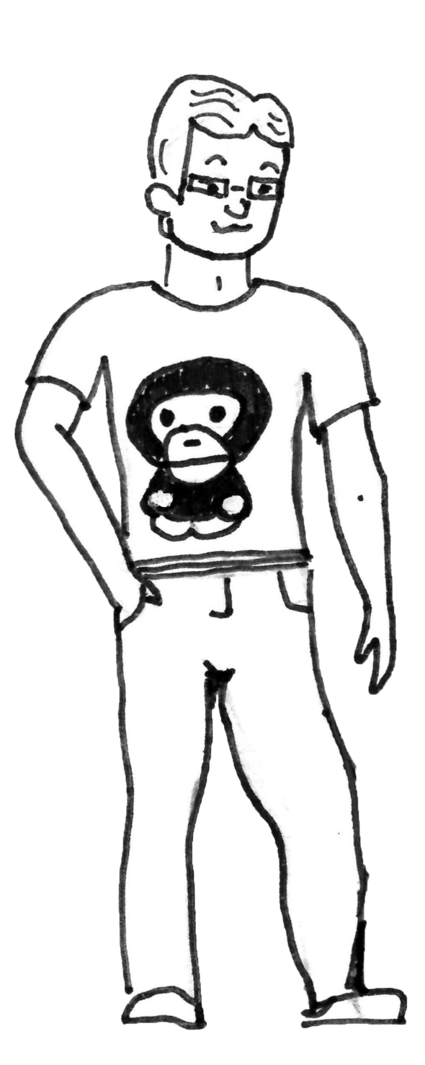
Excuse me.
Does this bus go to the zoo?
Excuse me.
Where do I get off to go to the park?
Excuse me.
Does the number 11 bus stop here?
Excuse me.
I’m looking for the hospital, does this bus go there?
Notes:
Explain some other ways of asking how to get somewhere.

Slide 7
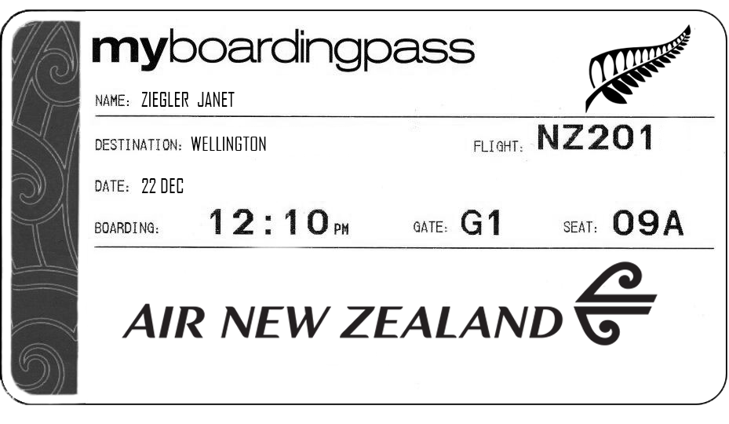

Slide 8
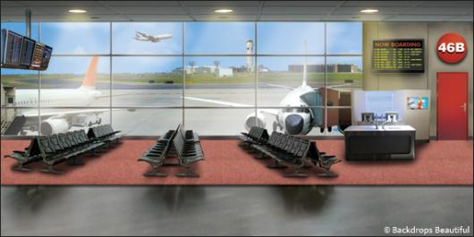

Slide 10
Excuse me.
Where is gate G1?
Excuse me.
Is this the right gate for flight NZ201?.
Excuse me.
Can you help me find gate G1?

Slide 11
Challenge time

Slide 12

Challenge time

Slide 13

Notes:
Get students into groups of 4. I just did this to avoid making so many big A3 maps, but if you want to make more maps, you can just do this in pairs.

Slide 14
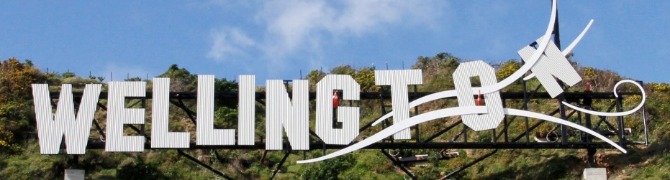
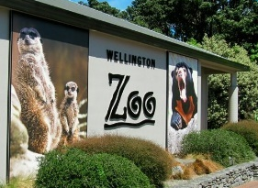
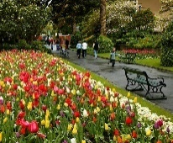
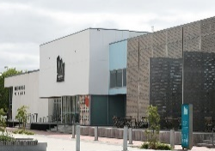
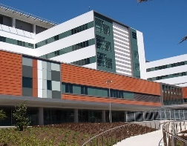
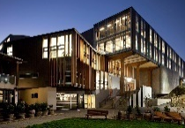
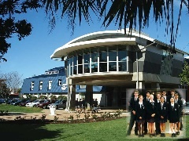

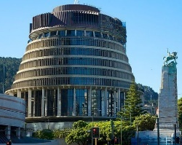
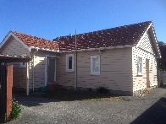
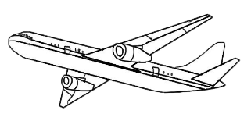
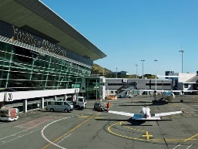
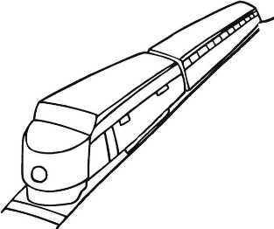
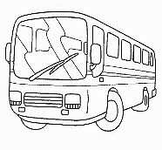
Upper Hutt station
Berhampore
Brooklyn
The zoo
The Dowse Art Museum
Lower Hutt
Silverstream station
Park
Newtown
Aro Valley
The Terrace
Massey University
Woburn Road
Taita station
Te Aro
The Hospital
Petone station
Hutt Valley High School
Courtenay Place
Waterloo station
Cuba Street
Lampton Quay
Wellington Station
Jessica’s House
The Beehive
Hutt Valley line
Number 1
Number 9
Wellington Airport
Upper Hutt line
Lower Hutt Line
Number 91
Number 11

